Slide 1
Domain ML
Technology: Python
Distracted Driver DetectionUsing Machine Learning Algorithm

Slide 2
ABSTRACT
The number of road accidents has constantly been increasing recently around the world. As per the national highway traffic safety administration’s investigation, 45% of vehicle crashes are done by a distracted driver right around each. We endeavor to build a precise and robust framework for distinguishing diverted drivers. The existing work of distracted driver detection is concerned with a limited set of distractions (mainly cell phone usage). This paper uses the first publicly accessible dataset that is the state farm distracted driver detection dataset, which contains eight classes: calling, texting, everyday driving, operating on radio, inactiveness, talking to a passenger, looking behind, and drinking performed by 26 subjects to prepare our proposed model. The transfer values of the pertained model EfficientNet are used, as it is the backbone of EfficientDet. In contrast, the EfficientDet model detects the objects involved in these distracting activities and the region of interest of the body parts from the images to make predictions strong and accomplish state-of-art results. Also, in the Efficientdet model, we implement five variants: Efficientdet (D0-D4) for detection purposes and compared the best Efficientdet version with Faster R-CNN and Yolo-V3.
Keywords: —Deep Neural Network, Convolutional Neural Network, Image Classification, Image Recognition, Transfer Learning, Machine learning.

Slide 3
INTRODUCTION
Every year more than 1 million people die due to the unsafe and dangerous driving all over the world. Distracted driving is one of the main causes for these road accidents. This is mainly due to the negligence of the drivers and secondary tasks done by the drivers while driving, such as answering a phone call, talking to co-passenger, texting, controlling the radio etc. According to the data published by ministry of road transport and highways[12], in India more than four lakh road accidents have been reported by different states and union territories (UT) in the calendar year 2018, claiming 1,51,417 lives and causing injuries to 4,69,418 persons. Another report from USA which has been reported by national highway traffic safety administration (NHTSA), said distracted driving accounted for 64.4% of the persons killed. Also 94% of the car accidents are caused by driver’s misbehaviour. Furthermore 86% of the drivers admit that they use any of the following: attending the calls, replying to the texts, checking GPS, talking to the fellow passenger, eating or drinking while driving, checking maps, watching video, grooming, and browsing web. These statements are further motivated to identify the ways to reduce the distracted driving. As pointed out, these inattention can lead to road accidents. Accidents can be reduced to a high extend if the drivers are warned at the moment the distraction is observed.

Slide 4
The proposed paper attempts to identify the distraction of drivers by the actions recorded in the camera. A camera is placed in the right side of the driving seat and record all the actions made by the driver. These body movements are categorized into 10 classes and if the actions or body movements falls in any of these classes, it is said that the driver is distracted. CNN based approach will help us to classify the driver as distracted or non-distracted based on the body movements.

Slide 5
LITERATURE SURVEY
[1] C. Yan, F. Coenen, and B. Zhang, “Driving posture recognition by convolutional neural networks,” IET Computer Vision, vol. 10, no. 2, pp. 103–114, 2016.
Driver fatigue and inattention have long been recognised as the main contributing factors in traffic accidents. This study presents a novel system which applies convolutional neural network (CNN) to automatically learn and predict pre-defined driving postures. The main idea is to monitor driver hand position with discriminative information extracted to predict safe/unsafe driving posture. In comparison to previous approaches, CNNs can automatically learn discriminative features directly from raw images. In the authors' works, a CNN model was first pre-trained by an unsupervised feature learning method called sparse filtering, and subsequently fine-tuned with classification. The approach was verified using the Southeast University driving posture dataset, which comprised of video clips covering four driving postures, including normal driving, responding to a cell phone call, eating, and smoking. Compared with other popular approaches with different image descriptors and classification methods, the authors' scheme achieves the best performance with an overall accuracy of 99.78%. To evaluate the effectiveness and generalisation performance in more realistic conditions, the method was further tested using other two specially designed datasets which takes into account of the poor illuminations and different road conditions, achieving an overall accuracy of 99.3 and 95.77%, respectively.

Slide 6
[2] Y. Abouelnaga, H. M. Eraqi, and M. N. Moustafa, “Realtime distracted driver posture classification,” arXiv preprint arXiv:1706.09498, 2017.
Distracted driving is one of the top three reasons for traffic fatalities. Every year, thousands of people are injured or killed in motor vehicle crashes resulting from distracted driving and recent technological advancements have increased the sources and frequency of distractions. This study provides a comprehensive literature review and a summary of findings for identifying best practices to collect and analyze data on distracted driving and countermeasures to mitigate distracted driving. It identifies literature published since 2006 that focuses exclusively on distracted driving. The results found that the severity of crashes involving distracted driving depends primarily on driver behavior and the geometric design of roadway and temporal variables. It was also found that several techniques exist to collect driver behavior data using dashcam cameras integrated into the dashboard of vehicles.

Slide 7
[3] Leonel Cuevas Valeriano, Paolo Napoletano,Raimondo Schettini. "Recognition of driver distractions using deep learning", 2018 IEEE 8th International Conference on Consumer Electronics - Berlin (ICCE-Berlin), 2018
The study of driver action recognition has been slowly gaining attention over the last decade due to its diverse number of applications, including those for improving the safety of drivers and passengers, providing driving assistance, supplying information to insurance companies and investigations and even for self-driving cars in situations when there might be a need for a human to take over control of the vehicle . According to the data published by the National Highway Traffic Safety Administration (NHTSA), in 2015, in the USA, 391,000 people were injured in motor vehicle crashes involving distracted drivers, while 3,477 were killed. Another of NHTSA’s 2015 traffic safety report indicates that driver’s misbehaviour is the critical reason for 94% of the car accidents, with mechanical problems or environmental circumstances being the critical reason for less than 5% . Furthermore, it has been stated that 37% of the drivers admit to check and answer their texts, with 18% doing so regularly while operating a vehicle, and an alarming 86% of drivers report any of the following: eating, drinking, using their GPS system / checking a map, watching a video, surfing the web or grooming .

Slide 8
[4] Manjula Kumari, C.V Hari, Praveen Sankaran."Driver Distraction Analysis Using Convolutional Neural Networks", 2018 International Conference on Data Science and Engineering(ICDSE), 2018
Driver distraction has remained a significant factor in a large number of motor-vehicle accidents. Detection of driver inattention is considered a major potential area of research so as to prevent a huge number of road accidents. This paper presents a methodology that utilizes deep neural networks to analyze driver distraction. A tuned convolutional neural network for the vehicle driver image set is developed and used to classify face pose and this information is used to estimate driver distraction. The final proposed network consists of five convolutional layers, few of them followed by pooling layers, ReLU layers and finally three fully connected layers. The network is trained and tested using the vehicle driver database developed during real time vehicle operation by 14 individuals in multiple scenarios. The proposed approach resulted in better accuracy when compared to standard linear and nonlinear embedding based algorithms.

Slide 9
[5] A. Harma, “Automatic identification of bird species based on sinusoidal modeling of syllables,” in 2003 IEEE International Conference on Acoustics, Speech, and Signal Processing, 2003. Proceedings.(ICASSP’03)., vol. 5. IEEE, 2003, pp. V–545
According to the World Health Organization (WHO) report, 1.35 million people worldwide die in traffic accidents each year. That is nearly 3 700 people dying on the world’s roads every day. "One of the most heart-breaking statistics in this report is that road traffic injury is the leading cause of death for people aged between 5 and 29 years". The report also shows that the total number of deaths increases from year to year and the most common cause behind these accidents is driver’s distraction. The use of a mobile phone while driving is widespread among young and novice drivers, adding further to the already high risk of crash and death among these groups. Telephone use while driving increases the likelihood of being involved in a crash by a factor of four, while texting increases crash risk by a factor of 23. Also, the drivers’ reaction times have also been shown to be 50% slower with telephone use than without. The National Highway Traffic Safety Administrator of United States (NHTSA) reported in 2016 the death of 3450 people and 391.000 people injured in car accidents due to distracted drivers. The same report states that 481.000 passenger vehicles are driven by people using handheld cell phones during the day. In the United States, around 10 people are killed and more than 1000 are injured in road crashes that are reported to involve a distracted driver. Neither in Romania the situation is not better.

Slide 10
EXISTING SYSTEM
Existing work of distracted driver detection is concerned with a small set of distractions (mostly, cell phone usage). Unreliable ad hoc methods are often used. In this paper, we present the first publicly available dataset for driver distraction identification with more distraction postures than existing alternatives. In addition, we propose a reliable deep learning-based solution that achieves a 90% accuracy.
Disadvantages:
• High complexity.
• Time consuming.
• Low Accuracy

Slide 11
PROPOSED SYSTEM
Here we are going to implement our model to detect the distracted driver with convolutional neural network (CNN) with better accuracy and the user just need to upload the driver image and the model will detect the category with a fraction of time.
Advantages:
• Highest accuracy
• Reduces time complexity.

Slide 12
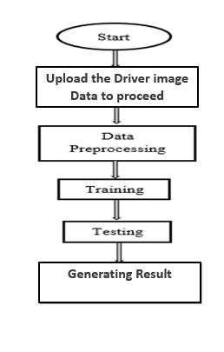
PROPOSED METHOD

Slide 13
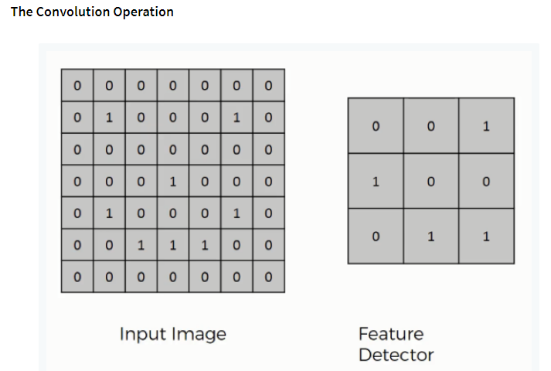
ALGORITHMS
Convolutional Neural Network (CNN)
Step1: convolutional operation
The first building block in our plan of attack is convolution operation. In this step, we will touch on feature detectors, which basically serve as the neural network's filters. We will also discuss feature maps, learning the parameters of such maps, how patterns are detected, the layers of detection, and how the findings are mapped out.

Slide 14
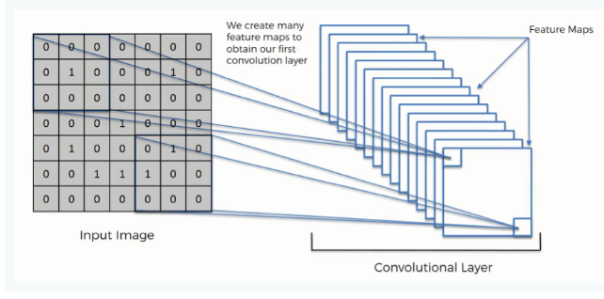
Step (1b): ReLU Layer
The second part of this step will involve the Rectified Linear Unit or Relook. We will cover Relook layers and explore how linearity functions in the context of Convolutional Neural Networks.
Not necessary for understanding CNN's, but there's no harm in a quick lesson to improve your skills.

Slide 15
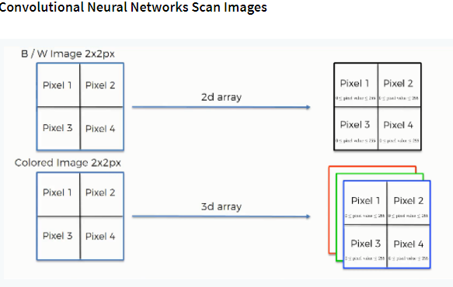
Step 2: Pooling Layer
In this part, we'll cover pooling and will get to understand exactly how it generally works. Our nexus here, however, will be a specific type of pooling; max pooling. We'll cover various approaches, though, including mean (or sum) pooling. This part will end with a demonstration made using a visual interactive tool that will definitely sort the whole concept out for you.

Slide 16
Step 3: Flattening
This will be a brief breakdown of the flattening process and how we move from pooled to flattened layers when working with Convolutional Neural Networks.
Step 4: Full Connection
In this part, everything that we covered throughout the section will be merged together. By learning this, you'll get to envision a fuller picture of how Convolutional Neural Networks operate and how the "neurons" that are finally produced learn the classification of images.
Summary
In the end, we'll wrap everything up and give a quick recap of the concept covered in the section. If you feel like it will do you any benefit (and it probably will), you should check out the extra tutorial in which Softmax and Cross-Entropy are covered. It's not mandatory for the course, but you will likely come across these concepts when working with Convolutional Neural Networks and it will do you a lot of good to be familiar with them.

Slide 17
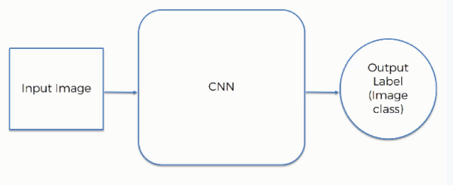
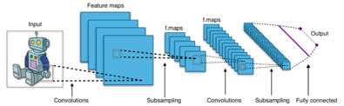
Fig 2. CNN Architecture

Slide 18
HARDWARE AND SOFTWARE REQUIREMENTS
H/W Configuration:
Operating system : Windows 7 or 7+
RAM : 8 GB
Hard disc or SSD : More than 500 GB
Processor : Intel 3rd generation or high or Ryzen with 8 GB Ram
S/W Configuration:
Software’s : Python 3.6 or high version
IDE : PyCharm.
Framework : Flask

Slide 19
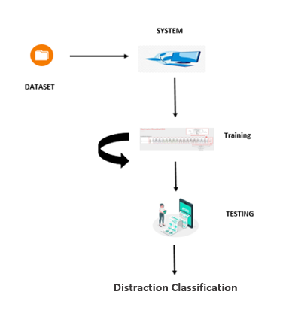
ARCHITECTURE:

Slide 20
MODULES:
System
User
1. System:
1.1 Create Dataset:
The dataset containing images of the distracted driver images of spinal cord with the two different classes which are to be classified is split into training and testing dataset with the test size of 30-20%.
1.2 Pre-processing:
Resizing and reshaping the images into appropriate format to train our model.
1.3 Training:
Use the pre-processed training dataset is used to train our model using CNN algorithm.
1.4 Classification:
The results of our model is display of classified images with their category names.

Slide 21
2. User:
2.1 Upload Image
The user has to upload an image which needs to be classified.
2.2 View Results
The classified image results are viewed by user.

Slide 22
UML DIAGRAMS
UML stands for Unified Modelling Language. UML is a standardized general-purpose modelling language in the field of object-oriented software engineering. The standard is managed, and was created by, the Object Management Group.
The goal is for UML to become a common language for creating models of object-oriented computer software. In its current form UML is comprised of two major components: a Meta-model and a notation. In the future, some form of method or process may also be added to; or associated with, UML.
The Unified Modelling Language is a standard language for specifying, Visualization, Constructing and documenting the artefacts of software system, as well as for business modelling and other non-software systems.
The UML represents a collection of best engineering practices that have proven successful in the modelling of large and complex systems.
The UML is a very important part of developing objects-oriented software and the software development process. The UML uses mostly graphical notations to express the design of software projects.

Slide 23
GOALS:
The Primary goals in the design of the UML are as follows:
Provide users a ready-to-use, expressive visual modelling Language so that they can develop and exchange meaningful models.
Provide extendibility and specialization mechanisms to extend the core concepts.
Be independent of particular programming languages and development process.
Provide a formal basis for understanding the modelling language.
Encourage the growth of OO tools market.
Support higher level development concepts such as collaborations, frameworks, patterns and components.
Integrate best practices.

Slide 24
USE CASE DIAGRAM
A use case diagram in the Unified Modeling Language (UML) is a type of behavioral diagram defined by and created from a Use-case analysis.
Its purpose is to present a graphical overview of the functionality provided by a system in terms of actors, their goals (represented as use cases), and any dependencies between those use cases.
The main purpose of a use case diagram is to show what system functions are performed for which actor. Roles of the actors in the system can be depicted.

Slide 25
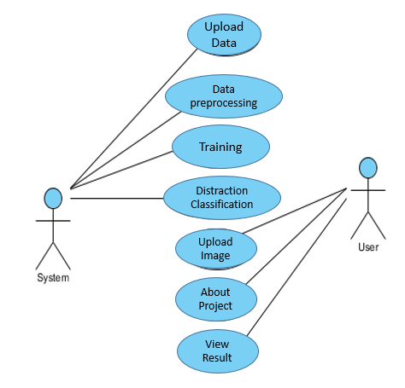

Slide 26
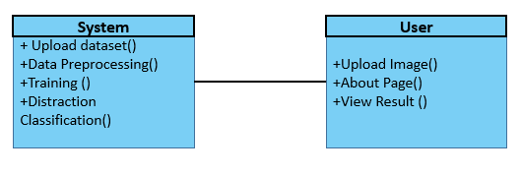
CLASS DIAGRAM
In software engineering, a class diagram in the Unified Modeling Language (UML) is a type of static structure diagram that describes the structure of a system by showing the system's classes, their attributes, operations (or methods), and the relationships among the classes. It explains which class contains information.

Slide 27
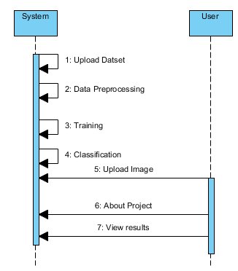
SEQUENCE DIAGRAM
A sequence diagram in Unified Modeling Language (UML) is a kind of interaction diagram that shows how processes operate with one another and in what order.
It is a construct of a Message Sequence Chart. Sequence diagrams are sometimes called event diagrams, event scenarios, and timing diagrams

Slide 28
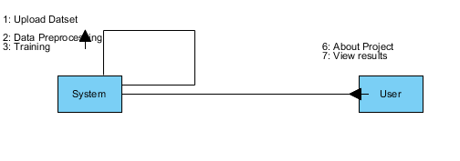
COLLABORATION DIAGRAM:
In collaboration diagram the method call sequence is indicated by some numbering technique as shown below. The number indicates how the methods are called one after another. We have taken the same order management system to describe the collaboration diagram. The method calls are similar to that of a sequence diagram. But the difference is that the sequence diagram does not describe the object organization whereas the collaboration diagram shows the object organization.

Slide 29
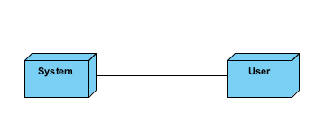
DEPLOYMENT DIAGRAM
Deployment diagram represents the deployment view of a system. It is related to the component diagram. Because the components are deployed using the deployment diagrams. A deployment diagram consists of nodes. Nodes are nothing but physical hardware’s used to deploy the application.

Slide 30
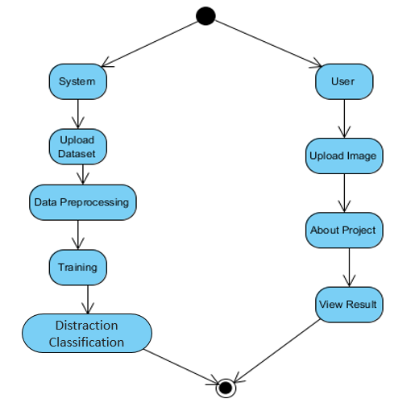
ACTIVITY DIAGRAM:
Activity diagrams are graphical representations of workflows of stepwise activities and actions with support for choice, iteration and concurrency. In the Unified Modelling Language, activity diagrams can be used to describe the business and operational step-by-step workflows of components in a system. An activity diagram shows the overall flow of control.

Slide 31
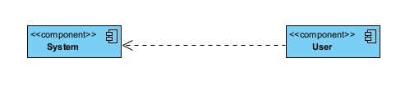
COMPONENT DIAGRAM:
A component diagram, also known as a UML component diagram, describes the organization and wiring of the physical components in a system. Component diagrams are often drawn to help model implementation details and double-check that every aspect of the system's required function is covered by planned development.

Slide 32
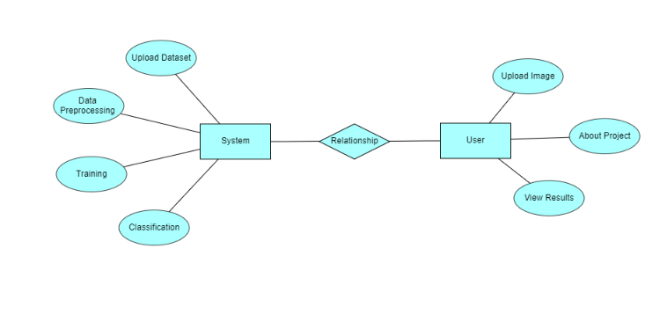
ER DIAGRAM:
An Entity–relationship model (ER model) describes the structure of a database with the help of a diagram, which is known as Entity Relationship Diagram (ER Diagram). An ER model is a design or blueprint of a database that can later be implemented as a database. The main components of E-R model are: entity set and relationship set.
An ER diagram shows the relationship among entity sets. An entity set is a group of similar entities and these entities can have attributes. In terms of DBMS, an entity is a table or attribute of a table in database, so by showing relationship among tables and their attributes, ER diagram shows the complete logical structure of a database. Let’s have a look at a simple ER diagram to understand this concept.

Slide 33
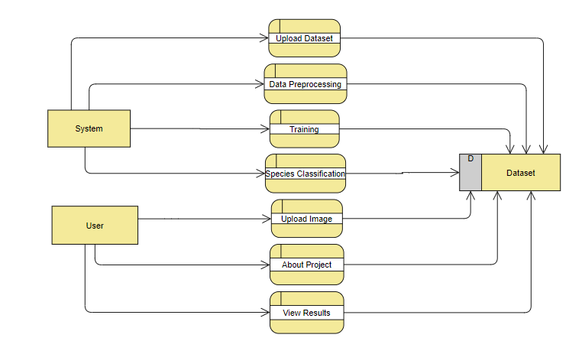
DFD DIAGRAM:
A Data Flow Diagram (DFD) is a traditional way to visualize the information flows within a system. A neat and clear DFD can depict a good amount of the system requirements graphically. It can be manual, automated, or a combination of both. It shows how information enters and leaves the system, what changes the information and where information is stored. The purpose of a DFD is to show the scope and boundaries of a system as a whole. It may be used as a communications tool between a systems analyst and any person who plays a part in the system that acts as the starting point for redesigning a system.

Slide 34
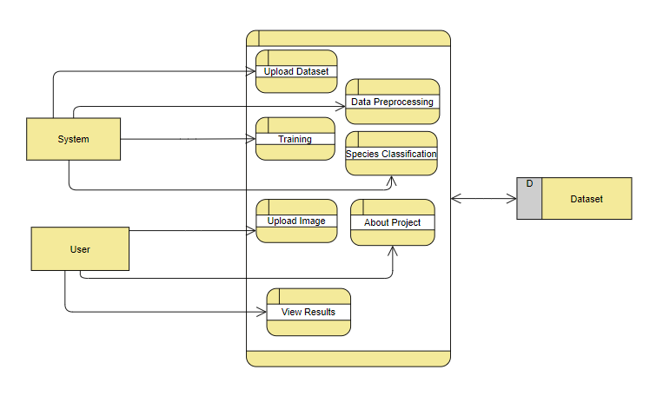

Slide 35
CONCLUSION:
Our research paper concludes that the CNN algorithm is the best approach for implementing technology to detect distrcation is to use a combination of machine learning algorithms. Studying all these past research works has been insightful and discovery. Techniques that nobody would have considered pre-historically have been overwritten once again with technology and the wonders it can do. These algorithms work well in a wide range of conditions and scenarios. It will be intended to determine various scoliosis related problems with early signs and symptoms which will be very useful in the medical field rather than the old traditional method of radiology where the result might not even be accurate and to avoid an unnecessary lengthy process of screening. Still we will continue our research work by applying more machine learning algorithms and deep learning algorithms for achieving better results for detection of distraction automatically.

Slide 36
FUTURE SCOPE
In near future we will collect more data in our context to increase the precision of our system. Also for future study, with an aim to achieve greater accuracy, more classification models will be investigated. Drawing an analogy between different works in the relevant work is not a simple job because of individual experimental protocols, so derived from the outcomes put up in this research and the implementation of the affiliated works, we can also contend intriguing field to study for distraction identification and we plan to work with Scale-Invariant Feature Transform (SIFT) features in future. In the next years it is evident that, deep learning is redefining the margins of the state-of-the-art and opens the door to more distant development as in this area beforehand.

Slide 37
REFERENCES:
[1] C. Yan, F. Coenen, and B. Zhang, “Driving posture recognition by convolutional neural networks,” IET Computer Vision, vol. 10, no. 2, pp. 103–114, 2016.
[2] Y. Abouelnaga, H. M. Eraqi, and M. N. Moustafa, “Realtime distracted driver posture classification,” arXiv preprint arXiv:1706.09498, 2017.
[3] Leonel Cuevas Valeriano, Paolo Napoletano,Raimondo Schettini. "Recognition of driver distractions using deep learning", 2018 IEEE 8th International Conference on Consumer Electronics - Berlin (ICCE-Berlin), 2018
[4] Manjula Kumari, C.V Hari, Praveen Sankaran."Driver Distraction Analysis Using Convolutional Neural Networks", 2018 International Conference on Data Science and Engineering(ICDSE), 2018
[5] S. Masood, A. Rai, A. Aggarwal, M. Doja, and M. Ahmad, “Detecting distraction of drivers using convolutional neural network,” Pattern Recognition Letters, 2018.

Slide 38
[6] Y. Yun, I. Y. Gu, M. Bolbat, and Z. H. Khan, “Videobased detection and analysis of driver distraction and inattention,” in Signal Processing and Integrated Networks (SPIN), 2014 International Conference on. IEEE, 2014, pp. 190–195
[7] A. Rangesh and M. M. Trivedi, “Handynet: A one-stop solution to detect, segment, localize & analyze driver hands,” arXiv preprint arXiv:1804.07834, 2018.
[8] P. Napoletano and S. Rossi, “Combining heart and breathing rate for car driver stress recognition,” in International Conference on Consumer Electronics - Berlin (ICCE-Berlin).
[9] Pandian, M. D. (2019),”Sleep Pattern Analysis And Improvement Using Artificial Intelligence And Music Therapy”Journal of Artificial Intelligence, 1(02), 54-62.
[10] Bashar, A. (2019),”Survey On Evolving Deep Learning Neural Network Architectures”,Journal of Artificial Intelligence, 1(02), 73-82.

Slide 39


